Slide 1
Auto Encoders in AI(Deep Learning)
Mr. Sreennivas Jilla
Lead AI-ML/Data Science/Gen AI Instructor

Slide 2
AUTO ENCODERS IN DEEP LEARNING
Introduction
In the world of deep learning, Auto-encoder is a type of neural network used for unsupervised learning and dimensionality reduction.
Autoencoders are very useful in the field of unsupervised machine learning
Auto-encoder is helpful in representing a bunch of datain to a compact form.
And way of compressing data into lower dimensions is known as the Encoding.
Auto-encoder also reverse the process of encoding to get original dimensions.
Autoencoders have various applications, from data denoising and anomaly detection to feature learning and generating new data samples.

Slide 3
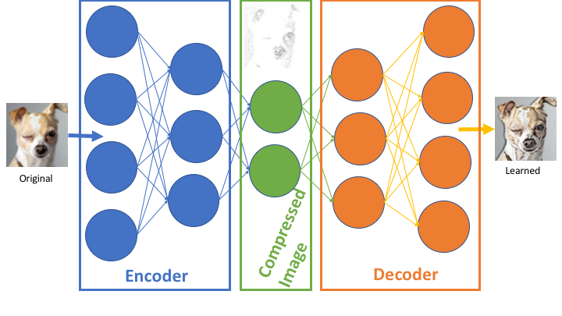
Illustration of AUTO ENCODERS

Slide 4
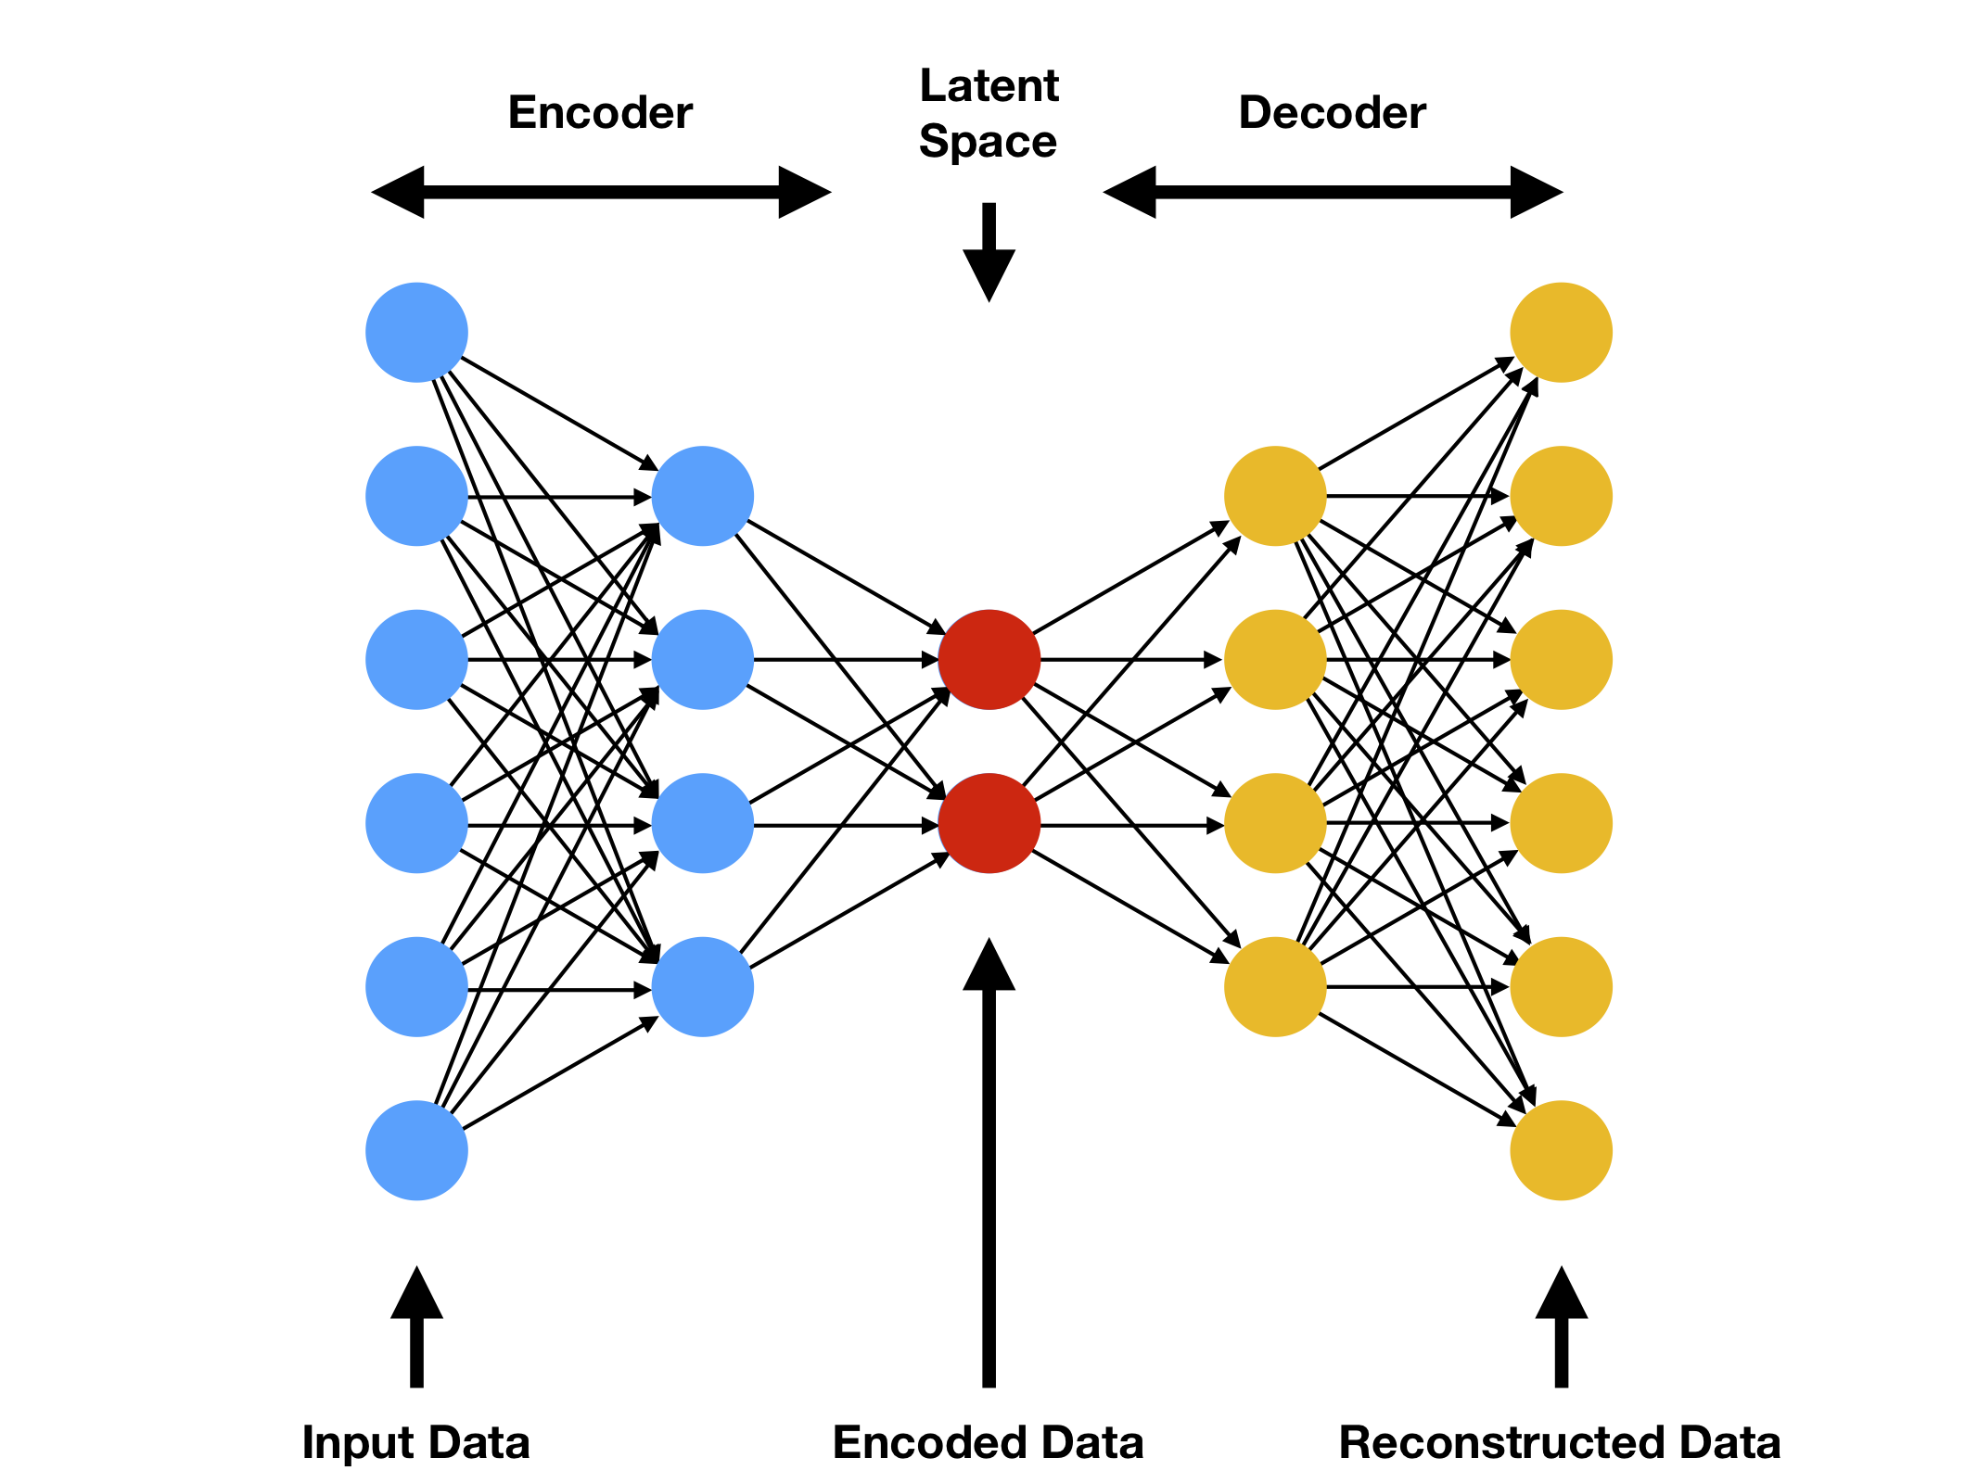
Architecture of AUTO ENCODERS

Slide 5
Architecture AUTO ENCODERS
Architecture
An Autoencoder is a type of neural network that can learn to reconstruct images, text, and other data from compressed versions of themselves.
An Autoencoder consists of three layers:
Encoder
Code
Decoder
The Encoder layer compresses the input image into a latent space representation. It encodes the input image as a compressed representation in a reduced dimension.
The compressed image is a distorted version of the original image.
The Code layer represents the compressed input fed to the decoder layer.
The decoder layer decodes the encoded image back to the original dimension.
The decoded image is reconstructed from latent space representation, and it is reconstructed from the latent space representation and is a lossy reconstruction of the original image.

Slide 6
Usage of autoencoders.
There are several usages of autoencoders, some major usages are:
Colouring of images
Autoencoders is used for colouring of any black and white picture. Depending on the picture it can be easily identified that which colour should be used for colouring.
Dimensionality Reduction
Autoencoders are used to reconstruct a given image by reducing its dimensions. Dimensionality reduction using autoencoders results from a similar image with reduced pixel values. Loss of picture information is almost minimal.
Removing noises from images.
Autoencoders are used to remove noises from input images. In this process, the original input image was reconstructed from the noisy image.
Feature Variation
One can extract the required feature of an image using autoencoder and generates the desired output by eliminating the noise or unnecessary interruption from the image.
Removing watermarks from images.
Using autoencoders, one can also remove the watermarks present in an image.

Slide 7
Types of autoencoders.
Denoising autoencoder: Denoising autoencoders make a ruined duplicate of the input by presenting some noise. These autoencoders take a somewhat corrupted input while preparing to recover the first undistorted information.
Sparse Autoencoder: Sparse autoencoders have hidden nodes more noteworthy than input nodes. They can, in any case, find significant highlights from the data. Their limitations were shown on the hidden layer.
Deep Autoencoder: Deep Autoencoders comprise of two indistinguishable deep conviction networks, one system for encoding and another for decoding.
Contractive Autoencoder: The target of a contractive autoencoder is to have a strong learned representation which is less delicate to little variation in the data.
Under complete Autoencoder: The target of under complete autoencoder is to catch the most significant highlights present in the data. Under complete autoencoders have a littler measurement for the hidden layer contrasted with the input layer.
Variational Autoencoder: Variational autoencoder models make solid suspicions concerning the appropriation of latent factors. They implement a variational approach for latent representation learning, which brings about a loss component and a particular estimator for the algorithm training called the Stochastic Gradient Variational Bayes estimator.

Slide 8
Working flow of Autoencoder
Encoding Magic:
Input Layer: The journey begins with the input layer, where your data is fed into the autoencoder.
Encoder Network: This network consists of multiple layers that progressively reduce the dimensionality of the input. Each layer transforms the data, capturing different levels of abstraction.
Bottleneck Revelation:
Bottleneck Layer: The lowest-dimensional layer, also known as the bottleneck or latent space, is where the data gets compressed into a concise representation. This layer holds the most essential features of the input.
Decoding Sorcery:
Decoder Network: This part of the autoencoder starts with the encoded representation and works its way back to reconstruct the original input. Like an artist recreating a masterpiece, the decoder transforms the encoded data step by step.
Reconstruction Unveiling:
Output Layer: The final layer of the autoencoder produces the reconstructed data. The goal during training is to make this output as close to the original input as possible.
Training Wizardry:
Loss Function: A key component in training is the loss function, which measures the difference between the input and the reconstructed output. The autoencoder adjusts its internal weights and biases to minimize this difference during training.

Slide 9
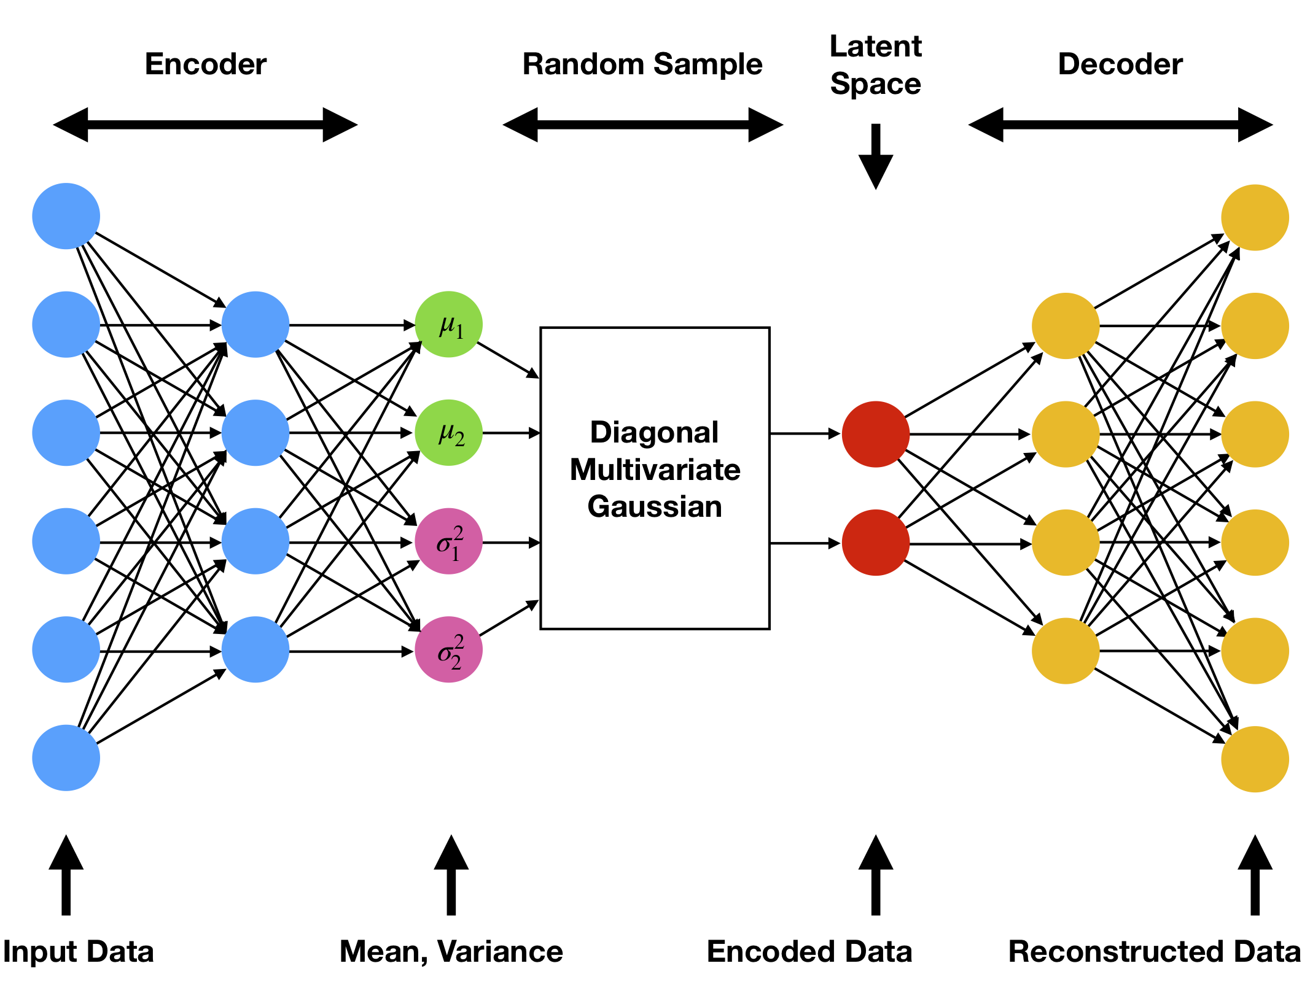
Variational Autoencoder(VAE)
The basic idea behind a variational autoencoder is that instead of mapping an input to fixed vector, input is mapped to a distribution.
The difference between the autoencoder and variational autoencoder is that bottleneck vector is replaced with two different vectors one representing the mean of the distribution and the other representing the standard deviation of the distribution.

Slide 10

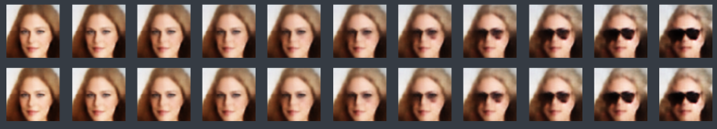
Data interpolation in Variational Autoencoder:
Facial Expression and Hair Color: Now we use linear interpolation to, for example, transition hair color to blond as follows. We take the difference ∆ of the center of the set of faces in our training set with blond hair and that of faces without blond hair. Then we add multiples of ∆ with increasing length to a face to gradually change its hair color to blond.
Using the same approach, we can also gradually add sunglasses to a face
we can gradually add sunglasses and change hair color at the same time

